Slide 1
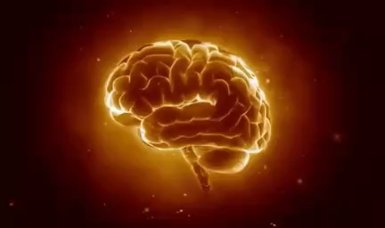

Brain Computer Interaction
Introduction to BCI

Slide 2
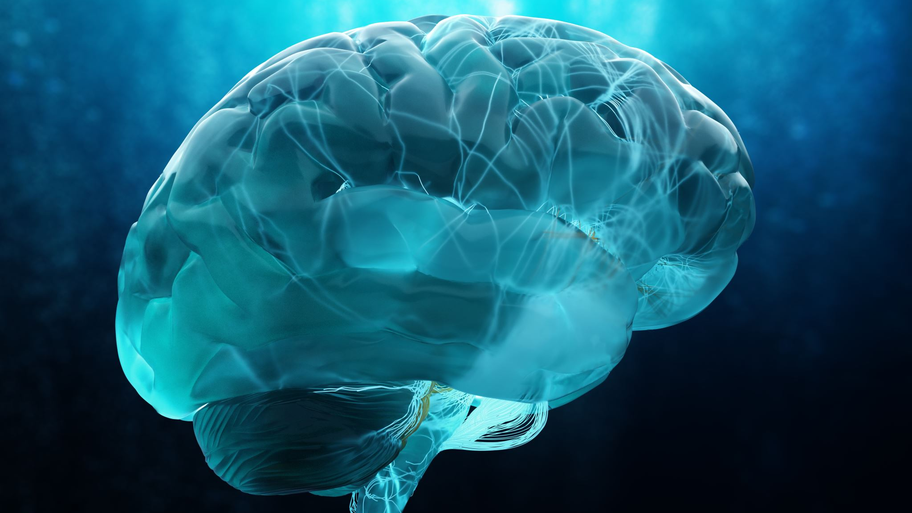
What’s Today
The Course Content
What is Brain Computer Interaction
History of BCI

Slide 3

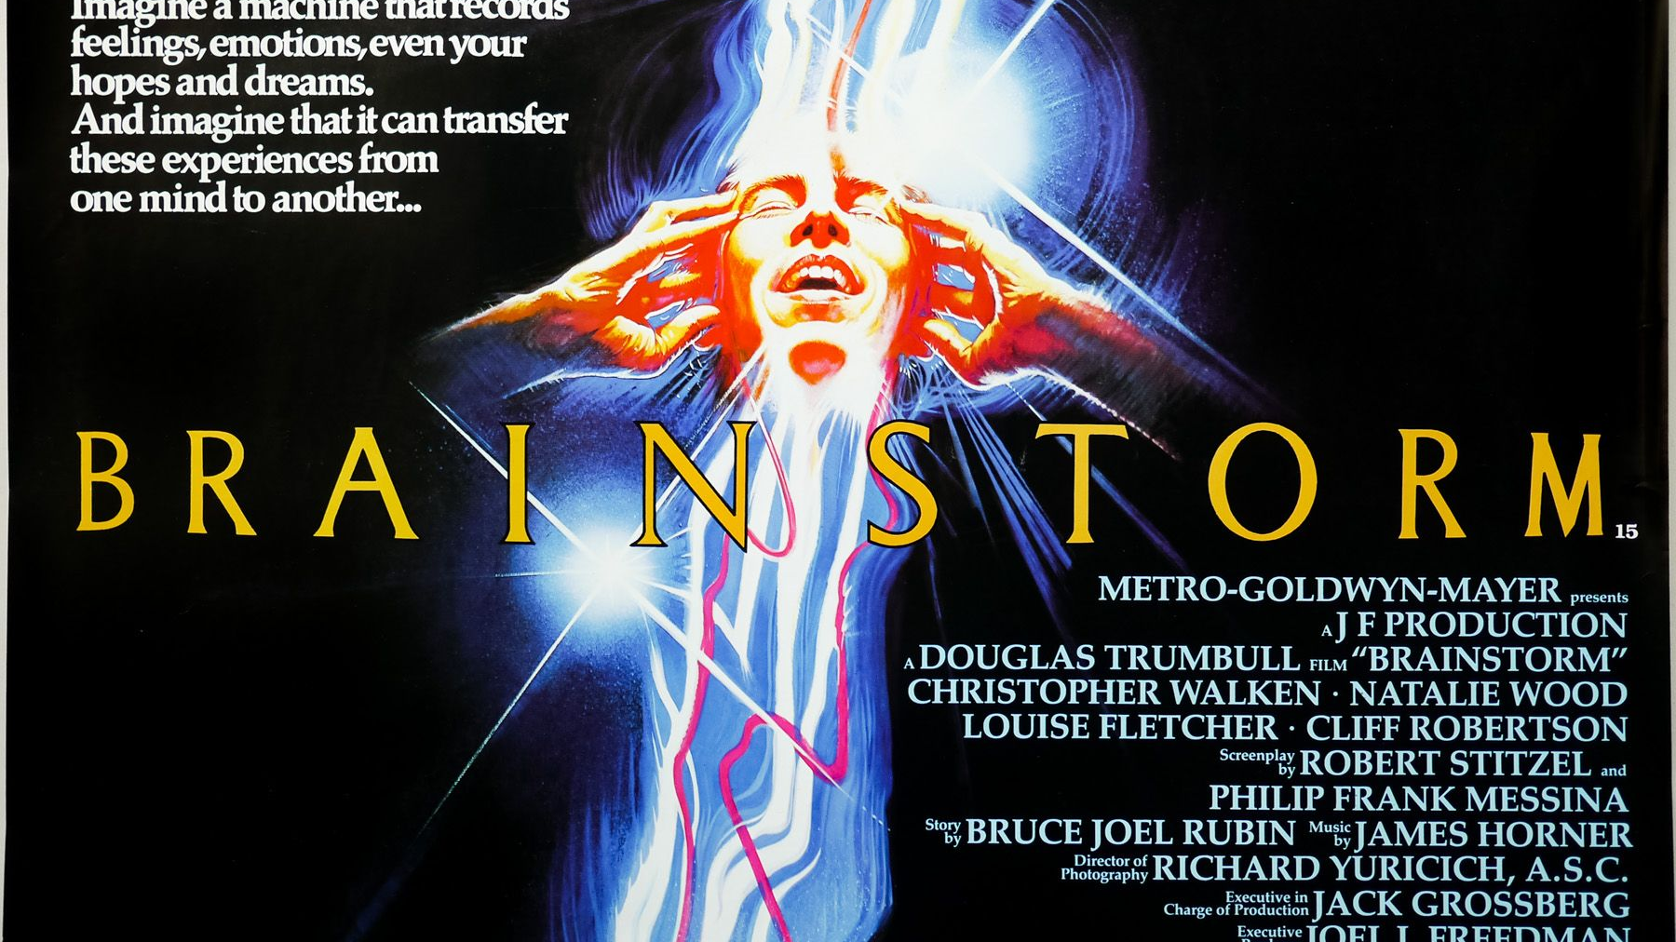

Slide 4
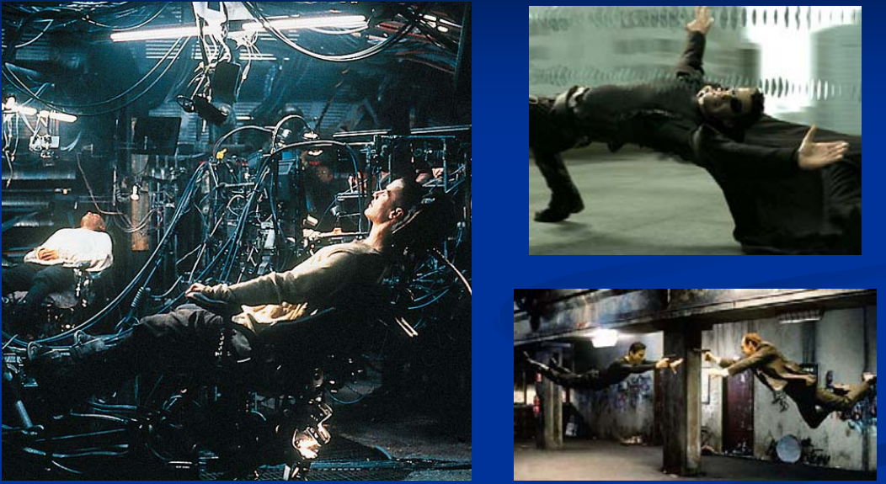

Slide 5
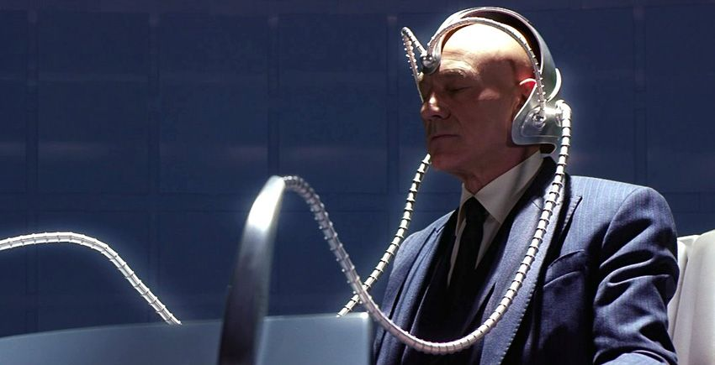



Slide 6

Is it FICTION or is it POSSIBLE???

Slide 7
Syllabus
Unit – 1 Introduction to Brain Computer Interface
Unit – 2 Introduction to Basic Neuroscience
Unit – 3 Modelling and Recoding of the Brain Signals
Unit – 4 Signal processing
Unit – 5 Signal Analysis using Machine Learning Approaches
Unit – 6 BCI Applications
Notes:
Modelling and Recoding of the Brain Signals- Brain computer interface types - Invasive, Semi-invasive, Non-invasive techniques; An Introduction to Non-Invasive Acquisition approaches - EEG, MEG, fNIRS, fMRI; EEG and Why EEG ; EEG Hardware-EEG electrode systems, EEG Data Acquisition approaches, Experimental setups, EEG Recording and analysis software; Neural Potentials- ERP, P300, SSVEP, ASSR, SCP, Motor Imagery. analysis softwares - Neural Potentials- ERP, P300, SSVEP, ASSR, SCP, Motor Imagery

Slide 8
Course Assessment
Mid Sem
End Sem
Quizzes
Surprise Quiz
Scheduled Quiz
Projects
Knowledge of Python or MATLAB required

Slide 9
Motivation for BCIs
Potential for restoring lost sensory and motor function
To control prosthetic devices such as prosthetic arms or legs for amputees and patients with spinal-cord injuries
Wheelchairs for paralyzed individuals
Cursors and word spellers for communication by locked-in patients
Sensory prosthetic devices such as cochlear implant for the deaf, retinal implant for the blind
More recently, researchers have begun exploring BCIs for able-bodied individuals for a host of applications such as Game, Entertainment to robotic avatars, biometric identification and Education.

Slide 10
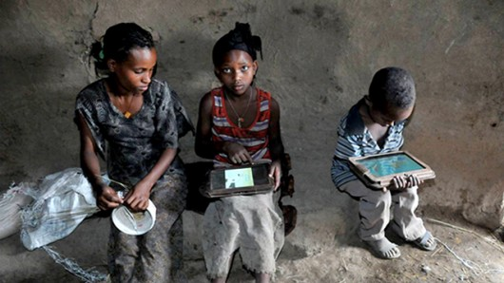
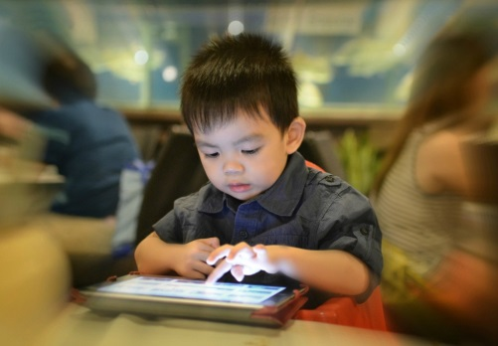


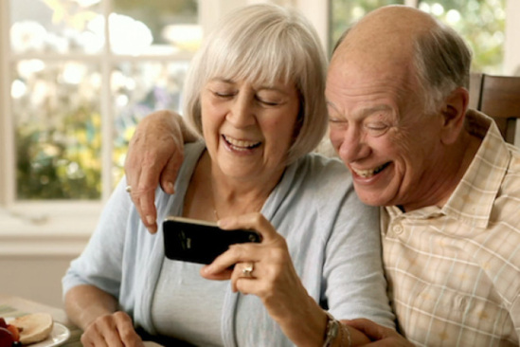
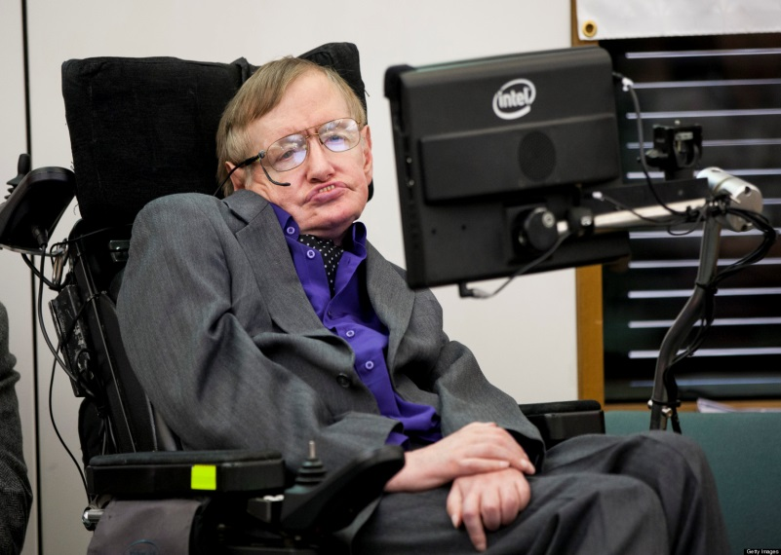
Users
Language illiterate
Next Gen HCI
Novice user
Blind user
Old-age people
Disabled user

Slide 11
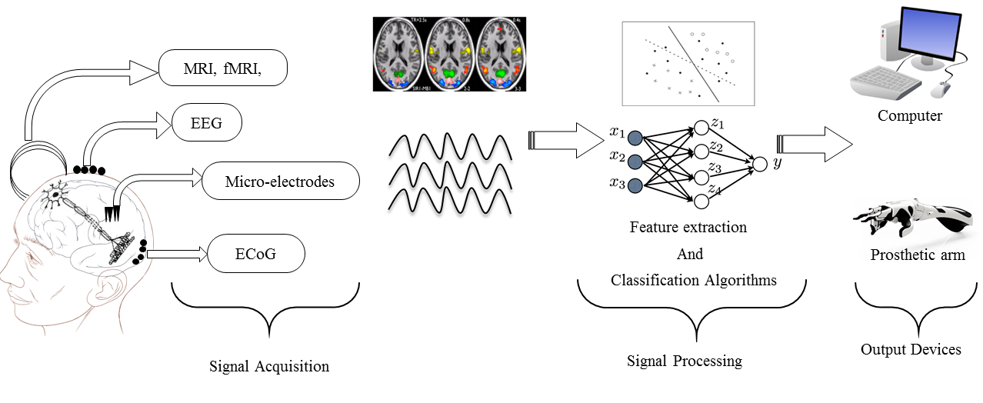
Brain Computer Interface
A system which translates thoughts and provides an interface used for communication called as Brain Computer Interface (BCI)
A typical BCI system comprises of signal acquisition system, signal processing (feature extraction and classification) and an output device
Image Credits: Bablani, Annushree, et al. "Survey on brain-computer interface: An emerging computational intelligence paradigm." ACM Computing Surveys (CSUR) 52.1 (2019): 1-32.

Slide 12
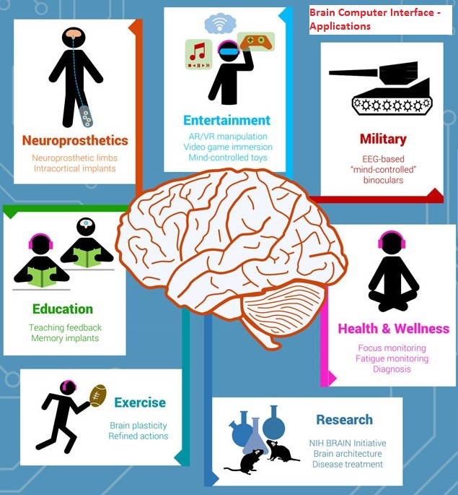
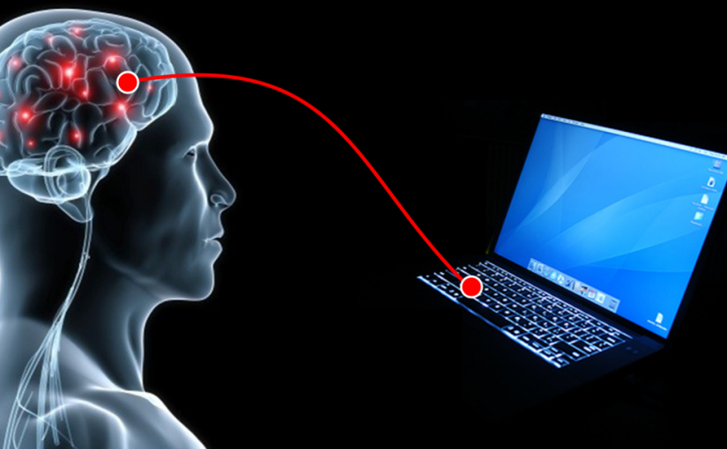
Brain Computer Interaction
Notes:
Holographic Technology that records the light scattered from an object and present it in high resolution 3D object that allows the user to interact with it without needing any special equipment.
Example: The video shows the future concept of iwatch.

Slide 13
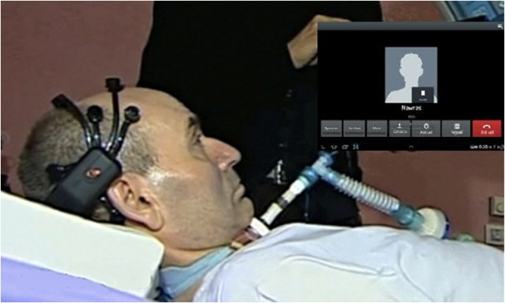
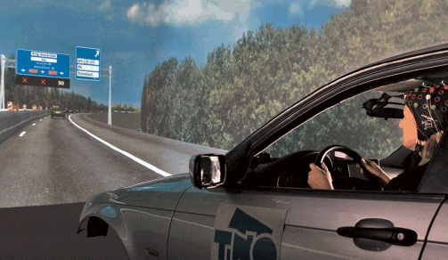
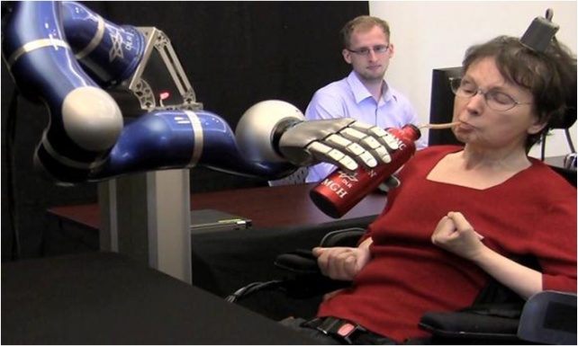
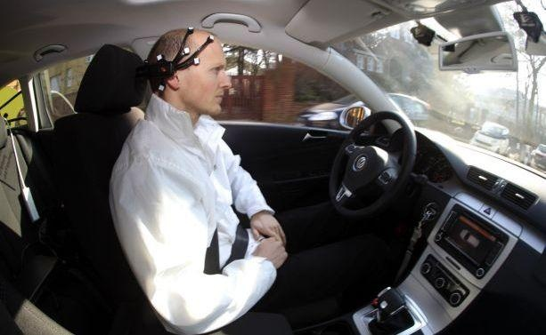
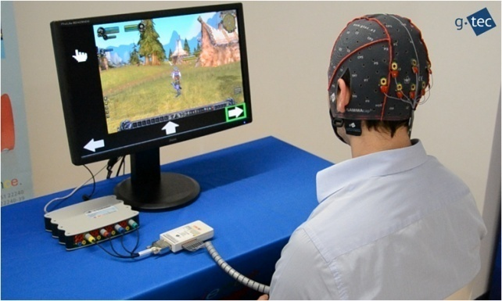
Some real-time BCI Applications
Communication
Attention Monitoring
Device Control
Automatic Motion Controlling
Games & Entertainment

Slide 14
Whether BCIs will eventually become as commonplace as current human accessories for sensory and motor augmentation, such as cellular phones and automobiles.????
That remains to be seen.
There are several moral and ethical challenges that society will need to address

Slide 15

History of Brain Computer Interaction

Slide 16
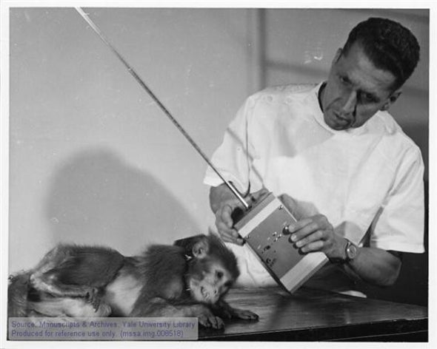
Timeline of BCI
1875
Electrical impulses from a living brain of a rabbit and monkey were recorded for the first time by Richard Caton
1890
Adolf Beck studied the brain activity of animals in response to sensory simulation
1913
Napoleon Cybulski studied the flow of electric current in muscles using his own capacitor.
1920
Hans Berger recorded EEG signals from the lesion area of the human scalp for the first time using a Siemens double-coil galvanometer and non-polarized electrodes.
1969
Delgado developed an implantable chip (which he called a “stimoceiver”) that could be used to both stimulate the brain by radio and send electrical signals of brain activity by telemetry, allowing the subject to move about freely.
Notes:
He is widely credited as the first to allow a severely paralyzed “locked-in” patient to move a computer cursor using her brain.
“The father of cyborgs,” one magazine called him.

Slide 17
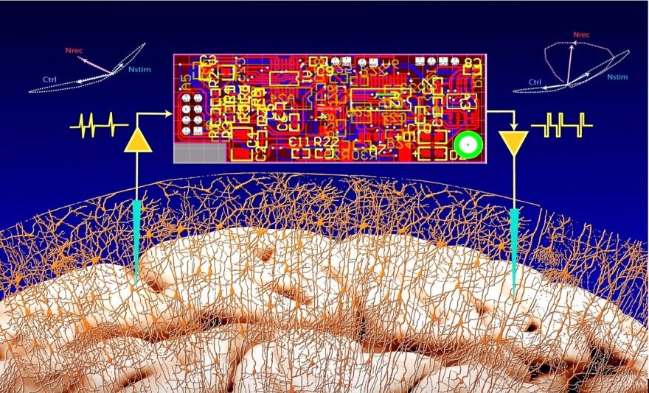
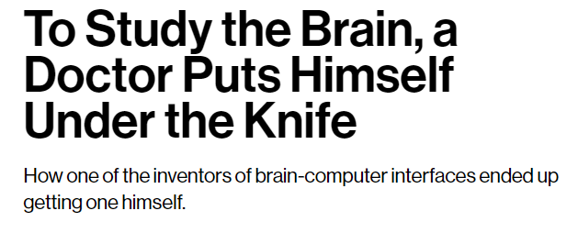
1969
Dr. Eberhard Fetz showed that neural activity could be used to drive an external device.
1973
Vidal in 1973 explored the use of scalp-recorded brain signals in humans to implement a simple noninvasive BCI based on “visually evoked potentials”
1990
Philip Kennedy had in 1990 developed “invasive” human brain-computer interface, wires inside the brain attached to a computer.
2001
John Donoghue and his team of Brown University in 2001, commercially design a brain computer interface, the so-called BrainGate.
2004
In 2004, Jonathan Wolpaw and researchers at New York State Department of Health’s Wadsworth Center demonstrated the ability to control a computer using a BCI.
June 2014
Phil Kennedy implanted electrodes into his brain in order to establish a connection between his motor cortex and a computer
Notes:
June 2004 marked a significant development in the field when Matthew Nagle became the first human to be implanted with a BCI, Cyberkinetics’s BrainGate

Slide 18
More recently, researchers have begun exploring BCIs for able-bodied individuals for a host of applications such as
Games
Entertainment to robotic avatars, biometric identification,
and Education.

Slide 19
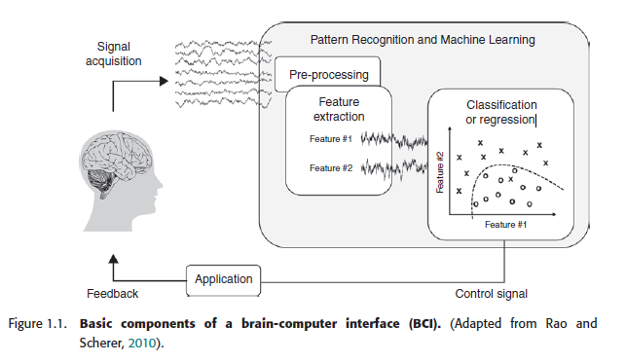
Our Goal in this course

Slide 20
BCI Applications

Slide 21
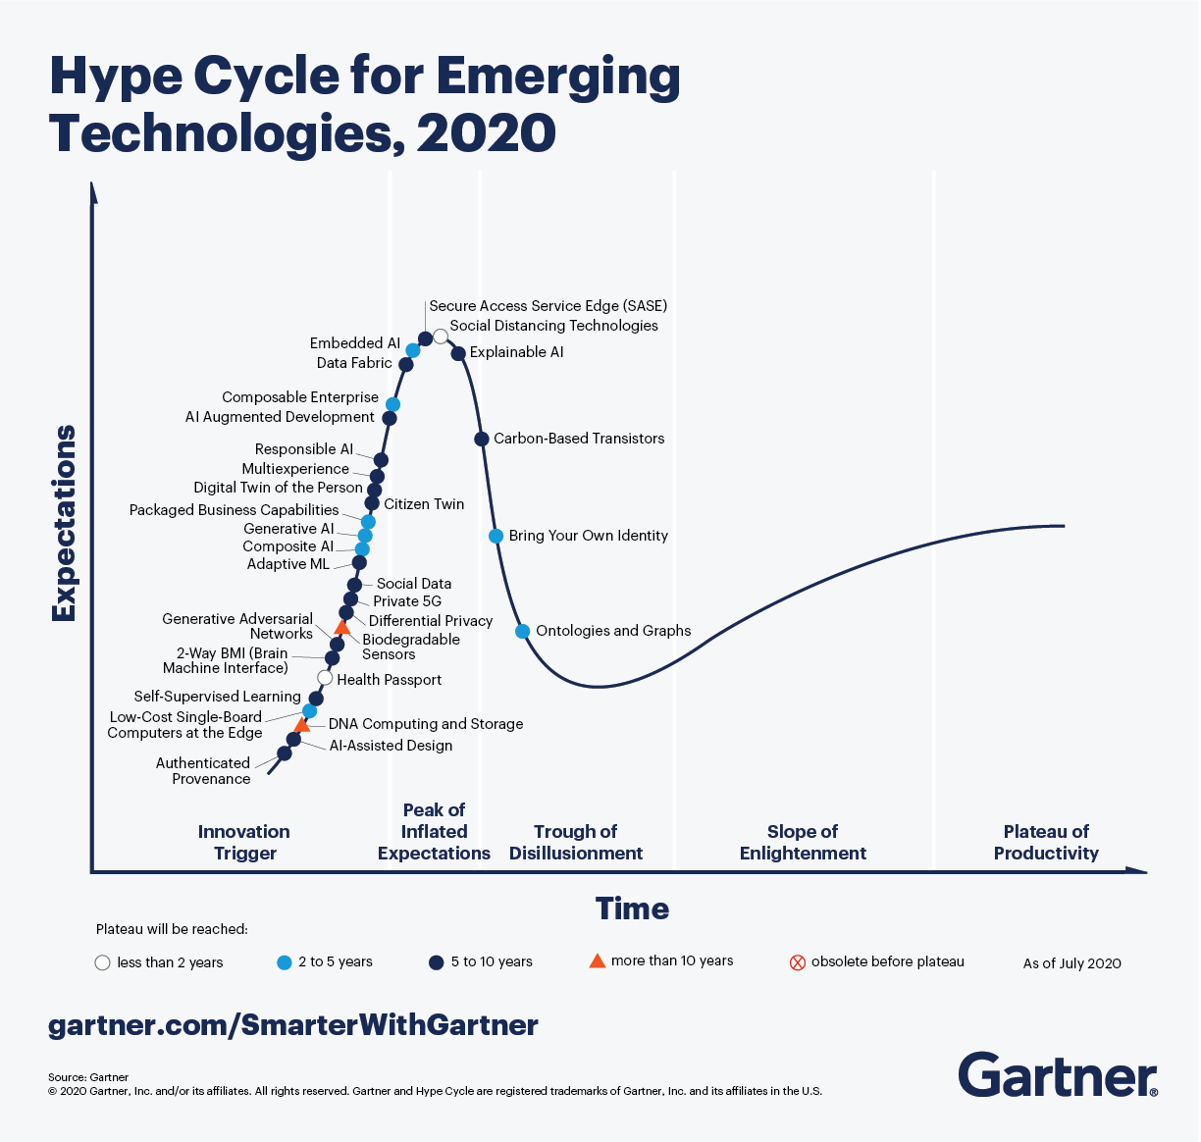

Slide 22
BCI Applications
Device Control
User State Monitoring
Training and Education
Games and Entertainment.
Cognitive improvement
Safety and Security

Slide 23
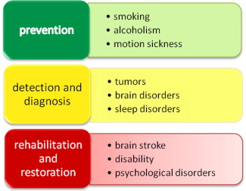
Medical Applications

Slide 24
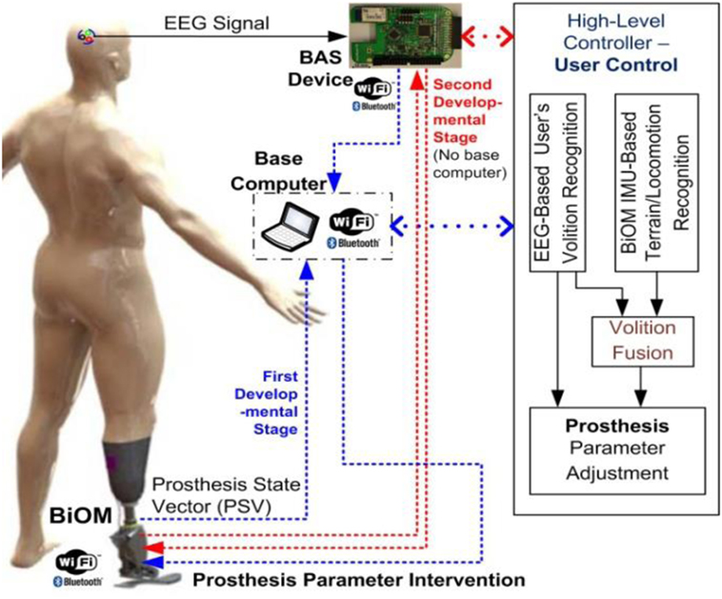

Device controls
For rehabilitation
Prosthetic arm
Prosthetic legs
Image credits: https://www.frontiersin.org/files/Articles/308916/fneur-08-00696-HTML/image_m/fneur-08-00696-g001.jpg

Slide 25
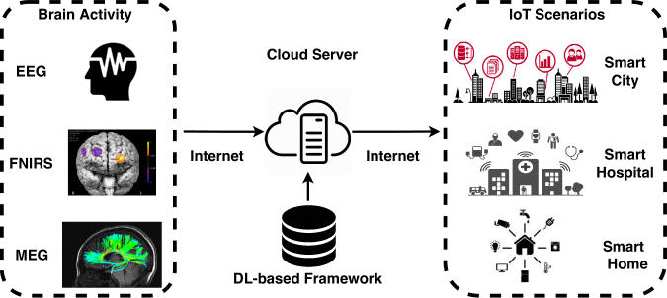
Neuroergonomics and smart environment
Cooperation between Internet of Things (IOT) and BCI technologies
intelligent transportation
by Xiang Zhang, et al. ∙
Notes:
The cloud server uses a person-dependent pre-trained deep learning model for analyzing the raw signals. The analysis results interpreted signals could be used for actuating functions in a wide range of IoT applicants such as smart city

Slide 26
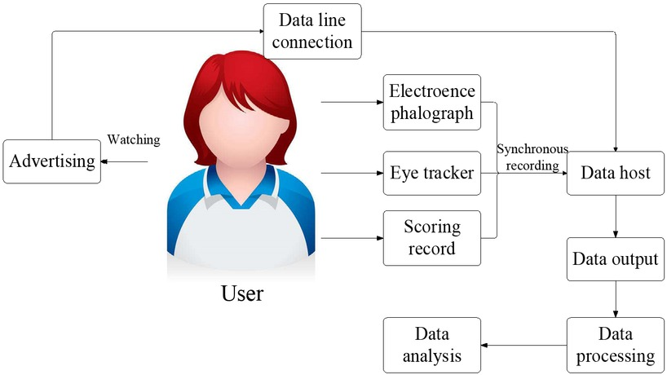
Neuromarketing and advertisement
EEG evaluation for TV advertisements related to both commercial and political fields.
The generated attention accompanying watching activity
Estimating the memorization of TV advertisements
https://doi.org/10.1515/tnsci-2019-0003

Slide 27
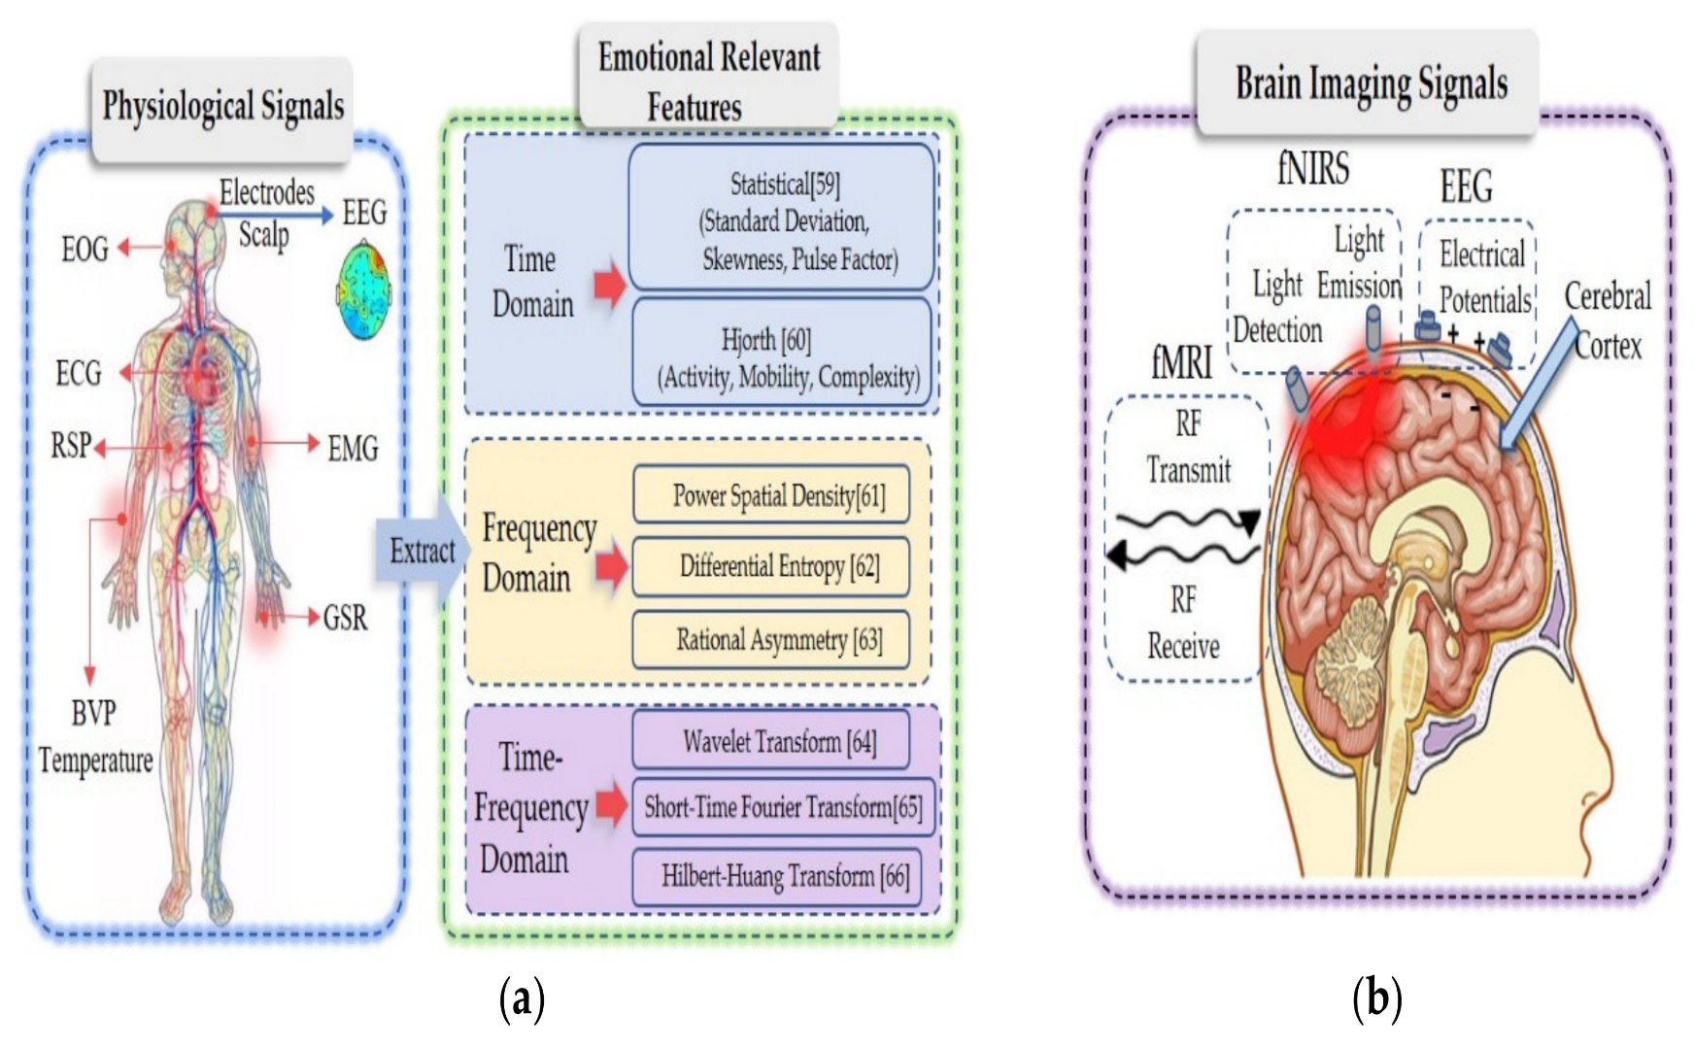
Educational and self-regulation
Emotional regulation
Use of fMRI–EEG BCI to fight the depression feeling as well as other neuropsychiatric disorders
Advances in Multimodal Emotion Recognition Based on Brain–Computer Interfaces
by Zhipeng He

Slide 28
Challenges
Usability
Hardware
Signal processing
System integration
Cost

